Slide 1
2.7 The NXT Computer U2C7

Slide 2
2.7 The NXT Computer
Overview:
This lesson explores the NXT as a computer. It is intended to follow the "Introduction to Computers" lesson.
Objectives: Students will be able to:
1. Identify the different parts the NXT computer
2. Describe the role of the different types of memory chips in the NXT computer

Slide 3
Worksheet
The NXT Computer Name:__________________ Period:___ Date:______ Score:___/14
(4 pts) Name the four parts of a computer & give an example of an NXT component for each.
(4 pts) Identify which part of a computer each of the following NXT component represent:
The Brick buttons:
Sound sensor:
Light:
LCD screen:
The Brick’s “brain”:
Touch sensor:
The Brick’s Flash memory:
(3 pts) Which NXT component can be used as two different parts of a computer?
Describe how.
(3 pts) What are the three types of memory chips? How is each used in the NXT computer?
Notes:
Answer Key:
The NXT Computer_Worksheet [1]
Submitted by Randy Steele [2] on 12 July, 2011 - 07:47
Answer Key: The NXT Computer Worksheet
Input – NXT Brick Buttons, Sensors, Motors Output – NXT Brick LCD Screen, NXT Brick Speaker, Motors, Lights Processor – NXT Brick Processor (“brain”) Storage – NXT Brick Flash Memory Chips
See above
Motors – can be both inputs (rotation sensor) and outputs (motor movement) NXT Brick – LCD Screen and Speaker are outputs and Buttons are inputs
ROM – stores firmware from Lego RAM – stores student’s software (programs) when running Flash – stores both firmware and software
Source URL: http://stemrobotics.cs.pdx.edu/node/366

Slide 4
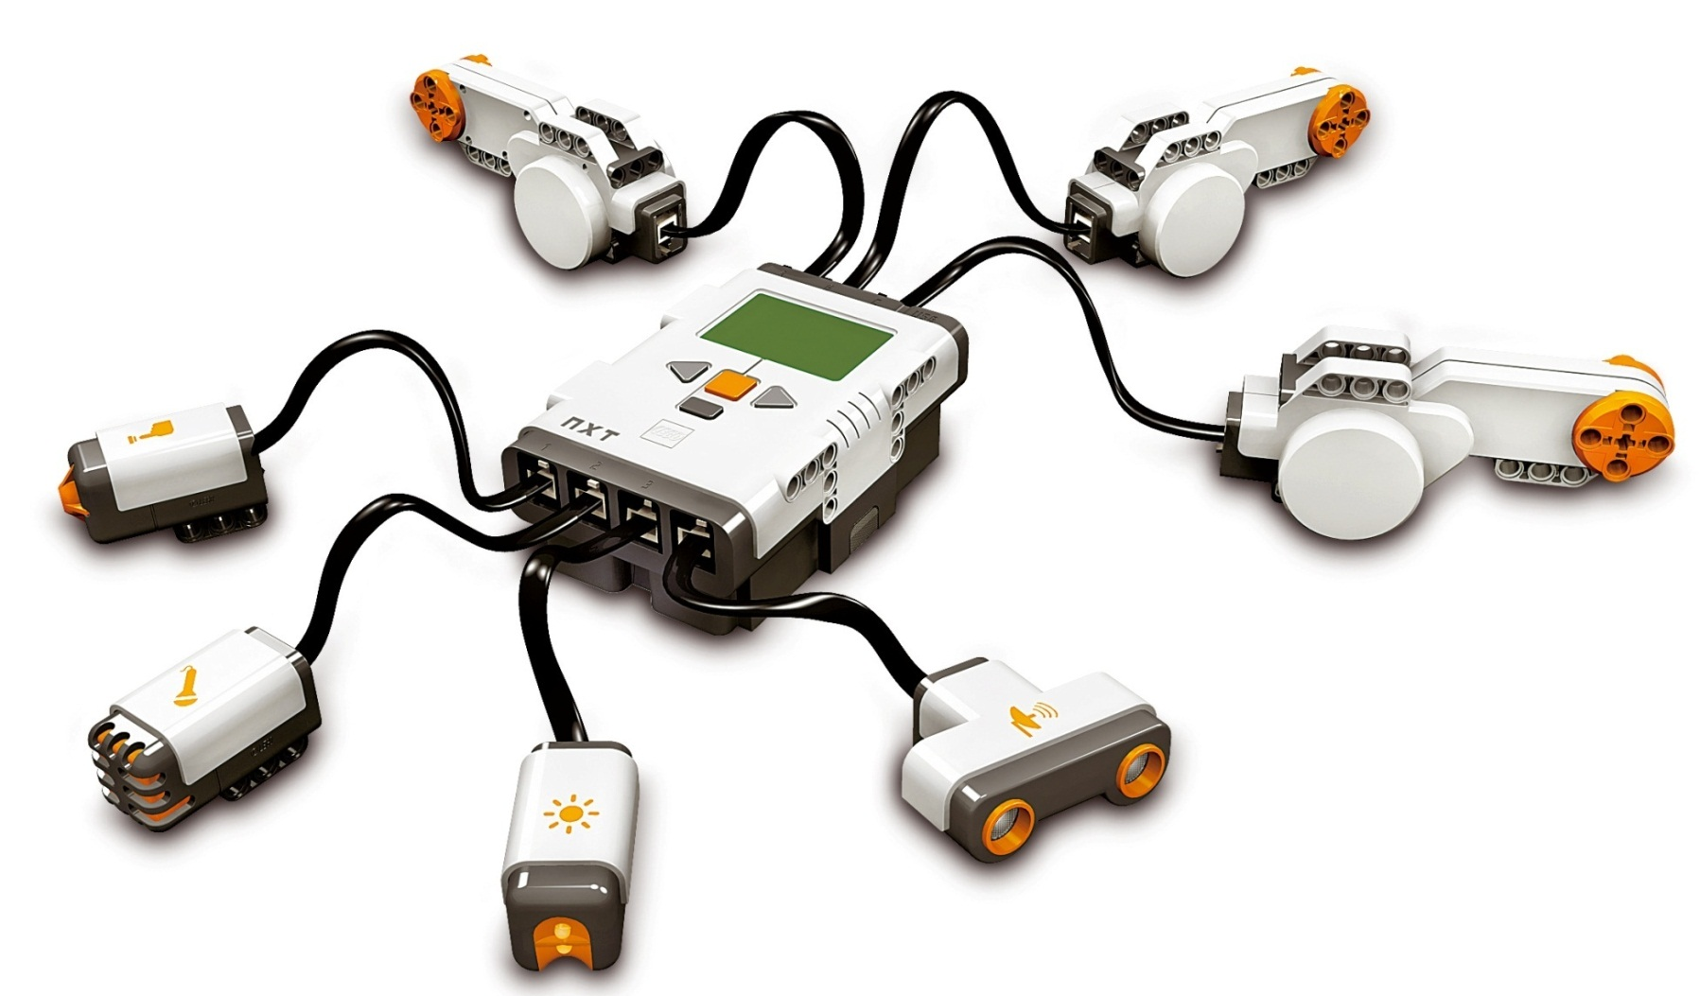
The NXT Computer
Inputs?
Outputs?
Processor?
Storage?
Notes:
Instruction Guide: The NXT Computer
Submitted by Randy Steele on 11 July, 2011 - 20:11
This lesson applies the learning from the Introduction to Computers lesson on the parts of a computer to the particulars of the NXT. Students also get a early glimpse of the NXT programming environment.
The Four Parts of the NXT Computer (see NXT Computer PPT : slide 1
Inputs– Sensors, brick buttons, motor encoder
Outputs – Motors, lights, brick screen, brick speaker
Processor – Brick processor
Storage –Brick memory chips – for firmware and software
Revisit processor and memory chips inside brick ( slide 2)
Flash memory chips storage the manufacturer’s firmware and user’s software
The NXT Motor – Output or Input? ( slide 3)
Answer: Both
Spinning motor is an output of the NXT computer
Semiconductor encoders are an input to the NXT computer
Students saw this in “View Mode” with motor
Motor encoders can tell NXT how many times the motor has been rotated

Slide 5
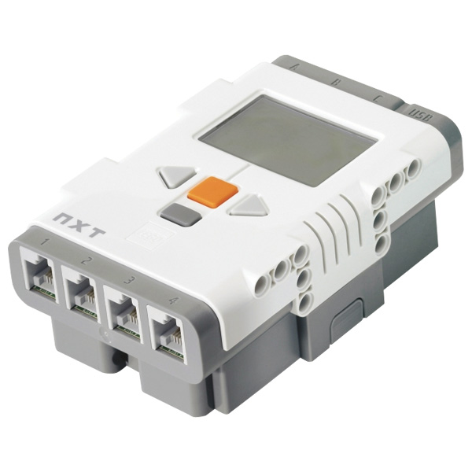
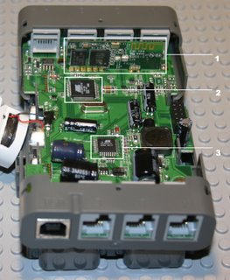
NXT Brick – Outside & Inside
Processor and Memory chips
Flash: Stores both Lego Firmware & your Software
RAM: Stores the Software while its running
Notes:
Revisit processor and memory chips inside brick ( slide 2)
Flash memory chips storage the manufacturer’s firmware and user’s software

Slide 6
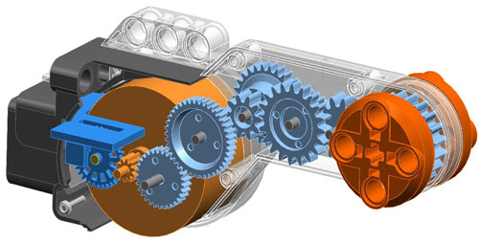
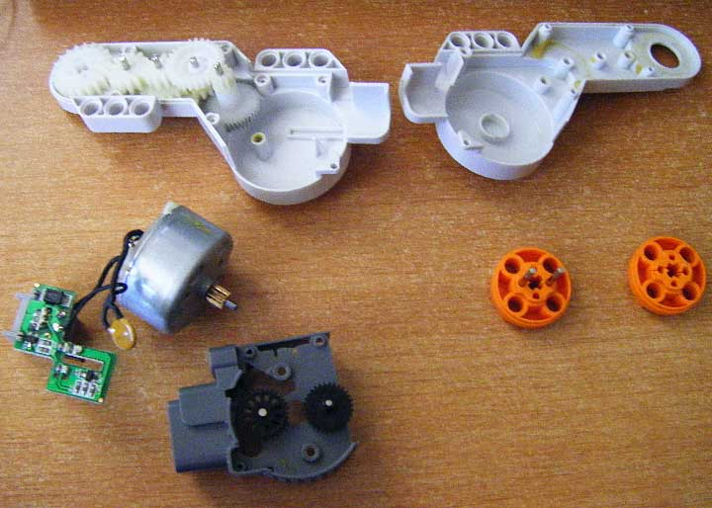
NXT Motor – Output or Input?
Answer:
Both
Motor (output) >>>>>>
Semiconductors >>>>>>>
embedded processor provides input to NXT
Notes:
The NXT Motor – Output or Input? ( slide 3)
Answer: Both
Spinning motor is an output of the NXT computer
Semiconductor encoders are an input to the NXT computer
Students saw this in “View Mode” with motor
Motor encoders can tell NXT how many times the motor has been rotated

Slide 7
NXT Computer Video
5:29-8:12
Notes:
Instructional Material: Show from 5:29-8:12
The NXT Computer_Video [1]
Submitted by Randy Steele on 12 July, 2011 - 08:05
This NXT Introduction video [3] was developed by Dale Yocum (Catlin Gabel School, Portland, OR) as part of his NXT Tutorial series. These videos have been linked as Alternative and Supplemental Differentiated Instructional Resources to their corresponding sections in this STEM Robo101 curriculum. This NXT Introduction video covers the NXT brick, sensors, menu system and more.
Material Type: Tutorial
Education Level: Middle School [4]High School [5]
Focus Subject: Robotics Hardware [6]Technology [7]
Interactivity Style: Mixed [10]
Copyright (c) 2011 by the author. All rights reserved.
Source URL: http://stemrobotics.cs.pdx.edu/node/371

Slide 8
The NXT Computer Demo
Connect a motor to any port (A, B, or C)
Connect a Touch Sensor to Port 1
3. Connect NXT to computer with USB cable
4. Start NXT-G software on computer 5. Under “File”, select “New
Inputs?
Outputs?
Processor?
Storage?
Notes:
NXT Computer Demo
Goals:
Demonstrate the four part of the NXT Computer
Emphasis is on Storage (students more readily grasp Input, Output, and Processor), specifically the Flash Memory Chip inside the NXT brick
Provide students their first glimpse of NXT-G programming software
Setup:
Connect a motor to any port (A, B, or C)
Connect a Touch Sensor to Port 1
Connect NXT to computer with USB cable
Start NXT-G software on computer
Under “File”, select “New
Place NXT and sensor under a Document Camera

Slide 9
The NXT Computer Demo
Procedure 1 (Explore existing contents of Flash Memory)
The NXT-G software is the environment we will be programming in
In the lower right of the programming field, there should be five buttons in a square-within-a-square pattern
Select the upper left button (with the embossed brick icon)
This should open a window with the “Communications” tab selected
Turn on the brick (Orange Button)
It should show up in the Communications window as “available”
Notes:
NXT Computer Demo
Procedure 1 (Explore existing contents of Flash Memory)
Show student NXT-G software and explain this is the environment they will be programming in
No need to explain icons or features at this time – this is just a teaser
In the lower right of the programming field, there should be five buttons in a square-within-a-square pattern
Select the upper left button (with the embossed brick icon)
This should open a window with the “Communications” tab selected
Turn on the brick
It should show up in the Communications window as “available”

Slide 10
The NXT Computer Demo
Select the available brick and press the “Connect” button
The “NXT Data” panel at the right side of the Communication window should populate with data from your brick
Name: the name can be changed from this window
Battery: show the current voltage of the brick’s battery
Connection: shows the brick is connected through the USB cable
Free Storage: shows the amount of free space on the NXT Flash Memory Chip
Note: NXT memory is measured in KB (KiloBytes),
Kilo means (1,000 or 0.001 MegaBytes)
NXT memory is very small, so learning to write efficient programs is very important
Firmware Version: shows version number of firmware stored in brick
Notes:
NXT Computer Demo
Procedure 1 (Explore existing contents of Flash Memory)
Show student NXT-G software and explain this is the environment they will be programming in
No need to explain icons or features at this time – this is just a teaser
In the lower right of the programming field, there should be five buttons in a square-within-a-square pattern
Select the upper left button (with the embossed brick icon)
This should open a window with the “Communications” tab selected
Turn on the brick
It should show up in the Communications window as “available”
Select the available brick and press the “Connect” button
The “NXT Data” panel at the right side of the Communication window should populate with data from your brick
Name: the name can be changed from this window
Battery: show the current voltage of the brick’s battery
Connection: shows the brick is connected through the USB cable
Free Storage: shows the amount of free space on the NXT Flash Memory Chip
Note: NXT memory is measured in KB (KiloBytes)
Ask student what kilo means (1,000 or 0.001 MegaBytes)
NXT memory is very small, so learning to write efficient programs is very important
Firmware Version: show version number of firmware stored in brick

Slide 11
The NXT Computer Demo
Select “Memory” tab (next to “Communication” tab in window)
This view shows the contents of the NXT Flash Memory Chip
The bar graph on the right graphically shows how much memory is used
By clicking on the underlined category headings (next to the various colored bar graph segments) the details of this category of files is displayed in window
By selecting the “Show System Files” check box, some of the firmware files installed by the manufacturer are also displayed.
Categories may include: Unused, Other, Graphic, Sound, Programs
Select the “Show System Files” check box, and select the Other category
These are files pre-installed by the manufacturer
The files named “Try-….” are the built in program we will be running in the next session of this unit
Select the “Close” button at the lower right of this window
Notes:
Select “Memory” tab (next to “Communication” tab in window)
This view shows the contents of the NXT Flash Memory Chip
The bar graph on the right graphically shows how much memory is used
By clicking on the underlined category headings (next to the various colored bar graph segments) the details of this category of files is displayed in window
By selecting the “Show System Files” check box, some of the firmware files installed by the manufacturer are also displayed.
Categories may include: Unused, Other, Graphic, Sound, Programs
Select the “Show System Files” check box, and select the Other category
These are files pre-installed by the manufacturer
The files named “Try-….” are the built in program we will be running in the next session of this unit
Select the “Close” button at the lower right of this window

Slide 12
The NXT Computer Demo
Procedure 2 (Download a sample user program into the NXT Flash Memory Storage)
Use “File”, “Open….” to open the sample program file in NXT-G (NXTComputerDemo.rbt )
I:\My Documents\Chief\IG's\Stem Robotics 101\Course - STEM Robotics 101\Unit 2 - Circuits and Computers\Lesson 2.7 - The NXT Computer
(This is what programs will look like in NXT-G)
What does this program do, based on the icon blocks
Turn on motor
Wait for Touch Sensor to be pressed
Stop motor
Wait for 1 second
Make a Sound
Display something
Wait 10 seconds
Notes:
NXT Computer Demo
Procedure 2 (Download a sample user program into the NXT Flash Memory Storage)
Use “File”, “Open….” to open the sample program file in NXT-G ( NXTComputerDemo.rbt )
Explain to students this is what their programs will look like in NXT-G
Ask students to guess what this program does, based on the icon blocks
Turn on motor
Wait for Touch Sensor to be pressed
Stop motor
Wait for 1 second
Make a Sound
Display something
Wait 10 seconds

Slide 13
The NXT Computer Demo
In the lower right of the programming field, on the five button square-within-a-square pattern:
Select the lower left button (with the embossed downward arrow)
This downloads the open program to the brick
Wait for “Complete” to show in the Downloading dialog box
In the lower right of the programming field, on the five button square-within-a-square pattern:
Select the upper left button (with the embossed brick icon)
In the new window, select “Memory” tab (next to “Communication” tab)
Select the Program item next to the Flash Memory Bar Graph
A list of all the user programs will appear in the window
NXTCompterDemo should now be on that list
We successfully downloaded the sample program to the brick’s Flash Memory Storage
Notes:
NXT Computer Demo
In the lower right of the programming field, on the five button square-within-a-square pattern:
Select the lower left button (with the embossed downward arrow)
This downloads the open program to the brick
Wait for “Complete” to show in the Downloading dialog box
In the lower right of the programming field, on the five button square-within-a-square pattern:
Select the upper left button (with the embossed brick icon)
In the new window, select “Memory” tab (next to “Communication” tab)
Select the Program item next to the Flash Memory Bar Graph
A list of all the user programs will appear in the window
NXTCompterDemo should now be on that list
We successfully downloaded the sample program to the brick’s Flash Memory Storage

Slide 14
The NXT Computer Demo
Procedure 3 (Run the sample program on the NXT computer)
Switch to the Document Camera view of the NXT brick, motor and touch sensor
From “My Files” > “Software Files”, select the NXTComputerDemo program
When you select “Run”, the selected program gets copied from the Flash memory into the RAM and the NXT processor will begin running the program:
Turn on motor – the motor will immediately start turning
Wait for Touch Sensor to be pressed – when you press the touch sensor, the program will move on
Stop motor – the motor will immediately stop
Wait for 1 second – there will be a one second pause
Make a Sound – the NXT will say “Good Job”
Display something – the NXT will display a smiley face
Wait 10 seconds – after a 10 second pause, the program will end
Notes:
NXT Computer Demo
Procedure 3 (Run the sample program on the NXT computer)
Switch to the Document Camera view of the NXT brick, motor and touch sensor
From “My Files” > “Software Files”, select the NXTComputerDemo program
When you select “Run”, the selected program gets copied from the Flash memory into the RAM and the NXT processor will begin running the program:
Turn on motor – the motor will immediately start turning
Wait for Touch Sensor to be pressed – when you press the touch sensor, the program will move on
Stop motor – the motor will immediately stop
Wait for 1 second – there will be a one second pause
Make a Sound – the NXT will say “Good Job”
Display something – the NXT will display a smiley face
Wait 10 seconds – after a 10 second pause, the program will end

Slide 15
Review Question 1
Which one of the 4 parts of a computer is
the NXT Orange Button?
A) Input
B) Output
C) Processor
D) Storage
E) None of the above
Notes:
Which one of the 4 parts of a computer is
the NXT Orange Button?
A) Input
B) Output
C) Processor
D) Storage
E) None of the above

Slide 16
Review Question 1
Which one of the 4 parts of a computer is
the NXT Orange Button?
A) Input
B) Output
C) Processor
D) Storage
E) None of the above
Notes:
Which one of the 4 parts of a computer is
the NXT Orange Button?
A) Input
B) Output
C) Processor
D) Storage
E) None of the above

Slide 17
Review Question 2
Which one of the 4 parts of a computer is
the NXT Brick LCD Screen?
A) Input
B) Output
C) Processor
D) Storage
E) None of the above
Notes:
Which one of the 4 parts of a computer is
the NXT Brick LCD Screen?
A) Input
B) Output
C) Processor
D) Storage
E) None of the above

Slide 18
Review Question 2
Which one of the 4 parts of a computer is
the NXT Brick LCD Screen?
A) Input
B) Output
C) Processor
D) Storage
E) None of the above
Notes:
Which one of the 4 parts of a computer is
the NXT Brick LCD Screen?
A) Input
B) Output
C) Processor
D) Storage
E) None of the above

Slide 19
Review Question 3
Which one of the 4 parts of a computer is
the Touch Sensor?
A) Input
B) Output
C) Processor
D) Storage
E) None of the above
Notes:
Which one of the 4 parts of a computer is
the Touch Sensor?
A) Input
B) Output
C) Processor
D) Storage
E) None of the above

Slide 20
Review Question 3
Which one of the 4 parts of a computer is
the Touch Sensor?
A) Input
B) Output
C) Processor
D) Storage
E) None of the above
Notes:
Which one of the 4 parts of a computer is
the Touch Sensor?
A) Input
B) Output
C) Processor
D) Storage
E) None of the above

Slide 21
Review Question 4
Which one of the 4 parts of a computer is
the NXT Brick’s Flash Memory?
A) Input
B) Output
C) Processor
D) Storage
E) None of the above
Notes:
Which one of the 4 parts of a computer is
the NXT Brick’s Flash Memory?
A) Input
B) Output
C) Processor
D) Storage
E) None of the above

Slide 22
Review Question 4
Which one of the 4 parts of a computer is
the NXT Brick’s Flash Memory?
A) Input
B) Output
C) Processor
D) Storage
E) None of the above
Notes:
Which one of the 4 parts of a computer is
the NXT Brick’s Flash Memory?
A) Input
B) Output
C) Processor
D) Storage
E) None of the above

Slide 23
Review Question 5
Which one of the 4 parts of a computer is
the NXT Brick’s Speaker?
A) Input
B) Output
C) Processor
D) Storage
E) None of the above
Notes:
Which one of the 4 parts of a computer is
the NXT Brick’s Speaker?
A) Input
B) Output
C) Processor
D) Storage
E) None of the above

Slide 24
Review Question 5
Which one of the 4 parts of a computer is
the NXT Brick’s Speaker?
A) Input
B) Output
C) Processor
D) Storage
E) None of the above
Notes:
Which one of the 4 parts of a computer is
the NXT Brick’s Speaker?
A) Input
B) Output
C) Processor
D) Storage
E) None of the above

Slide 25
Review Question 6
The NXT’s Processor is located in the….
A) Motor
B) Sound Sensor
C) Light Sensor
D) Touch Sensor
E) None of the above
Notes:
The NXT’s Processor is located in the….
A) Motor
B) Sound Sensor
C) Light Sensor
D) Touch Sensor
E) None of the above

Slide 26
Review Question 6
The NXT’s Processor is located in the….
A) Motor
B) Sound Sensor
C) Light Sensor
D) Touch Sensor
E) None of the above
Notes:
The NXT’s Processor is located in the….
A) Motor
B) Sound Sensor
C) Light Sensor
D) Touch Sensor
E) None of the above

Slide 27
Review Question 7
Which part of the NXT system can act as both an input and an output?
A) Touch Sensor
B) Sound Sensor
C) Light Sensor
D) Motor
E) None of the above
Notes:
Which part of the NXT system can act as both an input and an output?
A) Touch Sensor
B) Sound Sensor
C) Light Sensor
D) Motor
E) None of the above

Slide 28
Review Question 7
Which part of the NXT system can act as both an input and an output?
A) Touch Sensor
B) Sound Sensor
C) Light Sensor
D) Motor
E) None of the above
Notes:
Which part of the NXT system can act as both an input and an output?
A) Touch Sensor
B) Sound Sensor
C) Light Sensor
D) Motor
E) None of the above

Slide 29
Worksheet
The NXT Computer Name:__________________ Period:___ Date:______ Score:___/14
(4 pts) Name the four parts of a computer & give an example of an NXT component for each.
(4 pts) Identify which part of a computer each of the following NXT component represent:
The Brick buttons:
Sound sensor:
Light:
LCD screen:
The Brick’s “brain”:
Touch sensor:
The Brick’s Flash memory:
(3 pts) Which NXT component can be used as two different parts of a computer?
Describe how.
(3 pts) What are the three types of memory chips? How is each used in the NXT computer?
Notes:
Answer Key:
The NXT Computer_Worksheet [1]
Submitted by Randy Steele [2] on 12 July, 2011 - 07:47
Answer Key: The NXT Computer Worksheet
Input – NXT Brick Buttons, Sensors, Motors Output – NXT Brick LCD Screen, NXT Brick Speaker, Motors, Lights Processor – NXT Brick Processor (“brain”) Storage – NXT Brick Flash Memory Chips
See above
Motors – can be both inputs (rotation sensor) and outputs (motor movement) NXT Brick – LCD Screen and Speaker are outputs and Buttons are inputs
ROM – stores firmware from Lego RAM – stores student’s software (programs) when running Flash – stores both firmware and software
Source URL: http://stemrobotics.cs.pdx.edu/node/366

Slide 31
Introduction to Computers Review
Jeopardy
Notes:
This is the Unit review.

